Slide 1

PROJECT 4
MOVIE PROJECTIONS
CHRISTOPHER LYNCH
ALEXANDRE MAULE
SEAN SMITH
JONATHAN YANG

Slide 2

BACKGROUND
The objective was to build a data model that could predict if a movie would gross three times or more than the budget based on historical production information. Additionally, we analyzed the data to determine success drivers within the movie industry.

Slide 3
TECHNOLOGIES
GitHub
GitBash
Python
Jupyter notebooks
Tableau
Scikit Learn
SQL
Render
Pandas

Slide 4


DATA
The dataset was sourced from Kaggle.com
The original dataset consisted of 15 columns and 7669 rows of data
Limitations: The month from the release column needed to be separated from the rest of the data to make a classification. There were 2247 rows that contained null values. There were limited data points, therefore we expanded that data to 20 columns to increase the data model accuracy

Slide 5
DATA
Original Columns
name
rating
genre
year
released
score
votes
director
writer
star
country
budget
gross
company
runtime

Slide 6
DATA
Additional Columns Added
cpi
ticket
director_number
writer_number
star_number
sequel

Slide 7

DATA MODEL
55%
.5595325231552124
65%
.6574141979217529
Model #1
Model #2
72%
.7276119589805603
75%
.7559153437614441
Model #3
Model #4

Slide 8
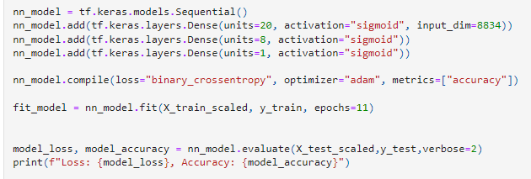
DATA MODEL #1

Slide 9
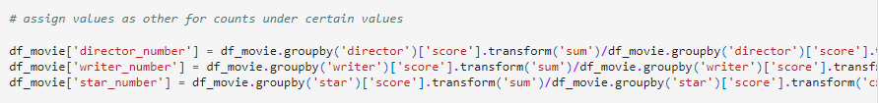
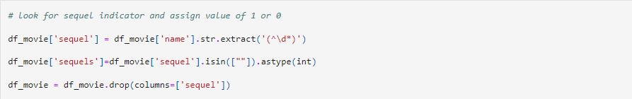
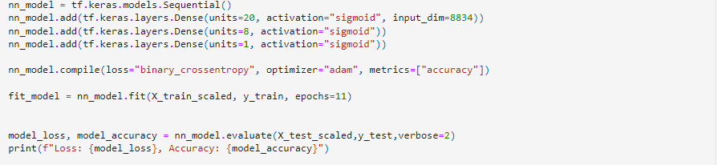
DATA MODEL #2

Slide 10
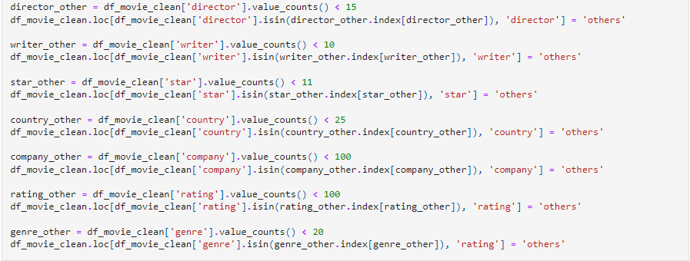
DATA MODEL #3

Slide 11
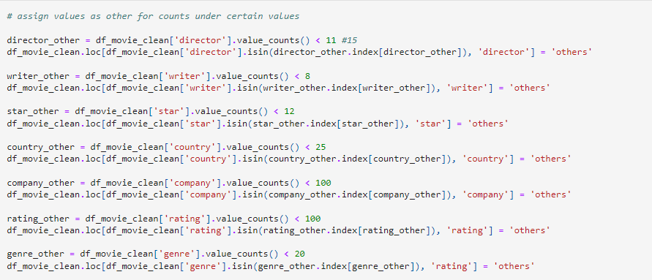
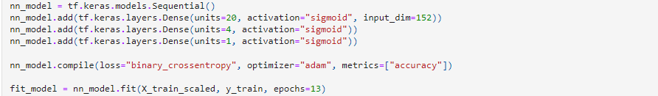
DATA MODEL #4

Slide 12

TABLEAU
Dashboard

Slide 13

QUESTIONS?

